Slide 1
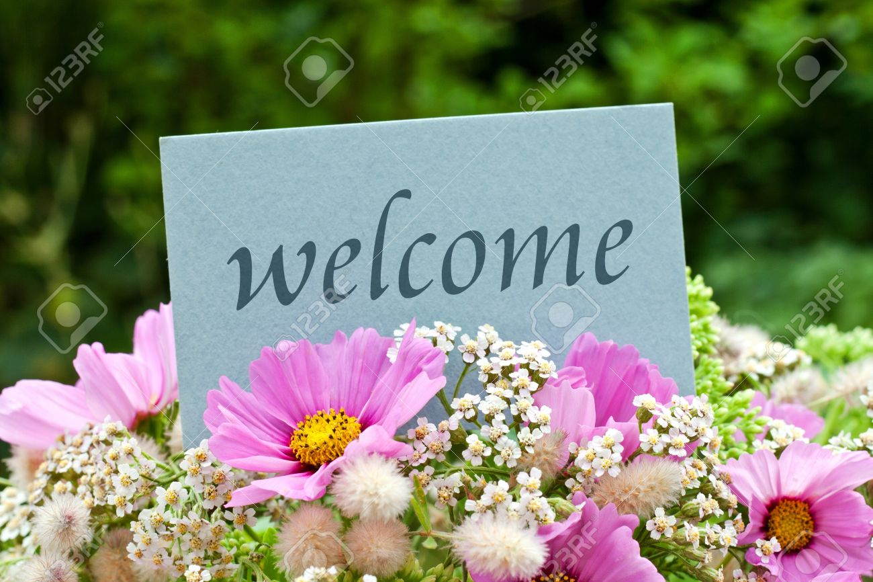

Slide 2
welcome
Welcome to the story of barter system so let’s began

Slide 3

Administrator
● As an administrator, I want users to sign up and login to the website so that they are authenticated users.
● As an administrator, I want to restrict book requests to only one active item request per user so that users one request is fulfilled before they can make another request

Slide 4

user
USER (Someone requesting the book)
● As a user, I want to request for a any thing of my choice by filling up a form so that I can display information about me and why I want to read a particular thing.
● As a user, I want to receive a notification is someone has sent me a item so that I know that my request has been responded to.
● As a user, I want to confirm that I have received a item that the donor knows that their item has reached the user.
● As a user, I would like to thank the thing donor so that they know the gratitude I feel for them.

Slide 5
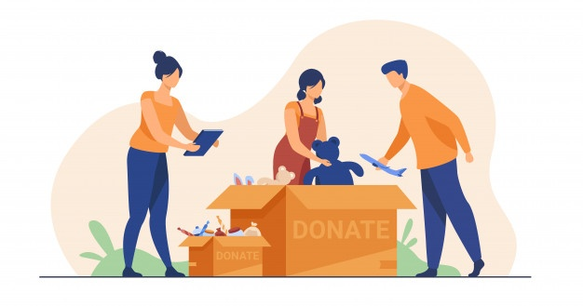
DONER
● As a item donor, I want to look at all the active book requests by different people so that I can read details on why someone wants to read that item.
● As a item donor, I want to filter the item requests using item search field so that I can look at requests for only items which I have.
● As a item donor, I want to look at the address of people making item requests so that I can send the item to them by post.
● As a item donor, I want to have a choice to pay for and send the item through online services like amazon so that I can send some one a item even if I don't have it.
● As a item donor, I want to send an update to a user that I have sent them the item so that the user knows that their request has been fulfilled.
● As a item donor, I want to be notified if user has received the item I sent so that I know that the item has reached them.

Slide 6


